Slide 1
IT1020 – Introduction to computer systems
Lecture 2:
Data Representation in Computer Systems

Slide 2
Lecture content
Data and Information
Data types
Data Representation in Computers
Error checking
Data Compression

Slide 3
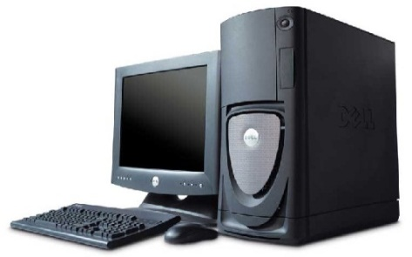
Data and Information: Related terms
What is a System?
A set of components get together for a particular purpose / to deliver a common service
A system has inputs, which will be processed and produced as output
Information System
Process
(by software)
Data
Information

Slide 4
Data and Information: Related terms
What is an Information System?
IS is a computer-based system to deliver information
Input: Data
Output: Information
Software Engineering
The engineering discipline of constructing Information Systems
Information and Communication Technology (ICT)
The technology used to engineer ISs

Slide 5
1. Data and Information
Data is a collection of raw facts
Numbers
Words
Measurements
Observations
Description of things
Information is the processed outcome of data.
It is derived from data
Saman Kamal Nuwan Maths English 50 60 70 80 90 40 100
Saman Maths 60 Kamal Maths 100 Nuwan Maths 40 Saman English 50 Kamal English 70 Nuwan English 80

Slide 6
Data and Information: What is Information?
Information provide meaningful values to the receiver
Timely - Information should be available when required
Accuracy - Information should be correct
Completeness - Information should be complete

Slide 7
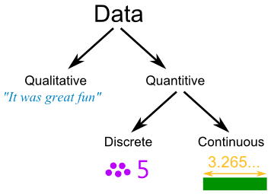
Data Types: Qualitative vs. Quantitative Data
Quantitative Data : Numerical Information
Qualitative Data : Descriptive data
Discrete data: Can only take certain values (within a range)
Continuous Data: Can take any value (within a range)

Slide 8
Data Types
Data types
Numerical
Textual
Integers
Real
Single character
Multiple characters
Digits
Alphabetical
Special
Numerical
Alphabetical
Alphanumerical

Slide 9
Data Types: Numeric data
Integer numbers
Whole numbers, + or -
4251/ -582 -582
Real (Decimal) numbers
All numbers including everything between integers
0.23, 0, 5½, -2.3,
Most significant digit
Least significant digit

Slide 10
Data Types: Character Data
Multiple characters (String)
Numeric 349, 53.781, …… Alphabetic Cat, Software, …… Special (#%$), ….. Alpha-numerical DIT451789#, ……..
Single character
Numeric/ digit 0, 1, 2, …… Alphabetic A, B, C, a, b, c, …… Special #, @, %, (, $, &, …..

Slide 11
Data Representation
Data representation refers to the form in which data is stored, processed, and transmitted
Devices such as smartphones, iPods, and computers store data in digital formats that can be handled by electronic circuitry.
Digitization is the process of converting information, such as text, numbers, photo, or music, into digital data that can be manipulated by electronic devices.
Notes:
Why data representation is required?

Slide 12
Data Representation
The Digital Revolution has evolved through four phases, beginning with big, expensive, standalone computers, and progressing to today’s digital world in which small, inexpensive digital devices are everywhere.

Slide 13

Data Representation in Computers: How do computers represent data?
Computers are digital
Recognize only two discrete states: on or off
Computers are electronic devices powered by electricity, which has only two states, on or off
Binary number system (0,1) is used for processing
1 1 1 1 1
0 0 0 0 0
What is the meaning of “Digital”?
What are the advantages of using binary number system?

Slide 14
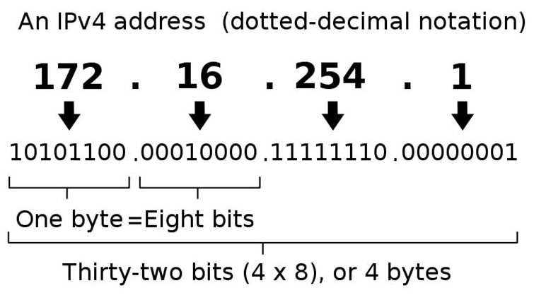
Data Representation in Computers. How do computers represent data?
Example of the use of binary numbers in data communication
IP addressing

Slide 15

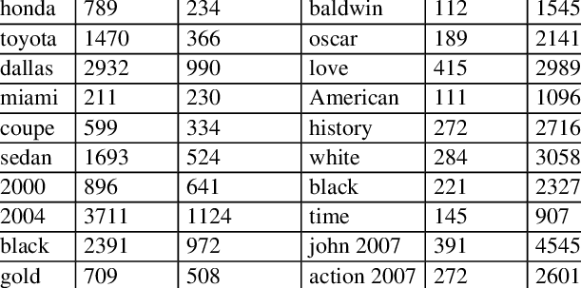

Data Representation in Computers How do we store data in a computer?

Slide 16
Data Representation in Computers: Binary number system
The memory is made up of BITS and BYTES
Single bit can hold a binary digit (0 or 1)
8 Bits = 1 Byte
1024 Bytes ＝ 1KB
1024 KB = 1 MB
1024 MB = 1 GB
1024 GB = 1 TB
2¹⁰ = 1024
104 KB: Kilobyte (KB or Kbyte)
50 Mbps: Megabits/sec
Terminology related to bits and bytes is extensively used to describe storage capacity and network access speed.

Slide 17
Data Representation in Computers Binary number system
Each BYTE can be addressed uniquely
When the address is expressed in Binary, the number of maximum BITs used to write the address specifies the total number of locations available
If n number of BITs are available then the total number of locations available is 2^{n}
If we have 32 BITs then we can have 4GB of Memory (2³² ＝ 4 GB)
What is the maximum amount of memory for 64bit computer?

Slide 18
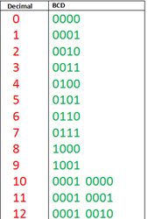
Data Representation in Computers BCD (Binary Coded Decimal)
4 bit code
(for numeric values only)

Slide 19
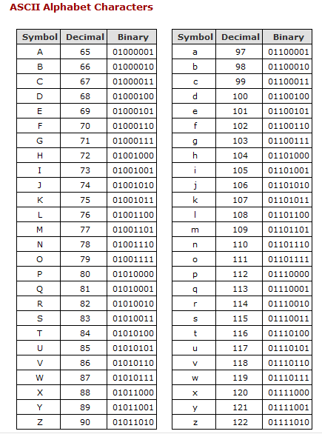
Data Representation in Computers ASCII (American Standard Code for Information Interchange)
ASCII
7 bit code for all 128 characters
A=1000001
Fundamentally, computers just deal with numbers. The letters and other characters are stored by assigning a number for each one
Extended ASCII
This system is an 8-bit system and allows the system to store up to 256 different characters

Slide 20
Data Representation in Computers ASCII

Slide 21
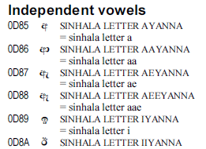
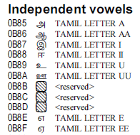
Data Representation in Computers Unicode
Unicode provides a unique number for every character
no matter what the platform
no matter what the program
no matter what the language
How many bits are used to represent a character?
How many characters can be represented?

Slide 22
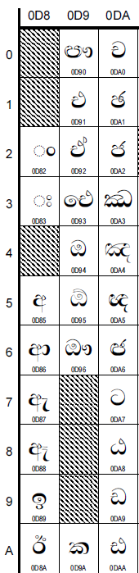
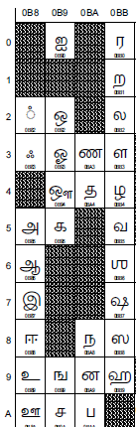
Data Representation in Computers: Unicode

Slide 23
Error checking: Parity
The parity is used in error checking, to find errors that may occur during data storing/transmission
A parity bit is a single bit added to a binary data transmission used to indicate if whether the 0's and 1's within that data transmission is an even or odd number

Slide 24
Error checking: Parity
There are two modes of parity
Odd parity:- The number of 1-bits (including the parity bit) must be an odd number
Even parity:- The number of 1-bits (including the parity bit) must be an even number
A single bit is appended to each data chunk (either as the least or most significant bit)
Makes the number of 1 bits even/odd
Example: even parity 1000000(1) 1111101(0) 1001001(1) | Example: odd parity 1000000(0) 1111101(1) 1001001(0)

Slide 25
Error checking: Parity – Example
You receive a binary word “11000101”
odd parity is used
Most significant bit is used for parity
Is the binary word correct?
The answer is: no:
There are 4 1-bits, which is an even number
We are using an odd parity
So, there must be an error.

Slide 26
Error checking: Parity – Example 2
Assume we are using even parity with 7-bit ASCII.
The letter V in 7-bit ASCII is encoded as 0110101.
How will the letter V be transmitted with parity?
Because there are four 1s (an even number), parity is set to zero.
This would be transmitted as: 0110101(0).

Slide 27
Error checking: Parity – Exercises
Add the odd parity bit as the least significant bit for the following data
0100101
1101101
1011001
0011010
1111011

Slide 28
Error checking : Parity – Exercises
Verify the correctness of the following data with the even parity bit on the most significant bit
01010001
10100101
01101101
01111011
10011010

Slide 29
Data Compression
To reduce file size and transmission times, digital data can be compressed.
Data compression refers to any technique that recodes the data in a file so that it contains fewer bits.
Compression is commonly referred to as “zipping”
The process of reconstituting zipped files is called extracting or unzipping.
Compressed files may end with a .zip, .gz, .pkg, or .tar.gz

Slide 30
Summary
Data and Information
Data types
Data Representation in Computers
Error checking
Data Compression

Slide 31
THANK YOU

